Slide 1
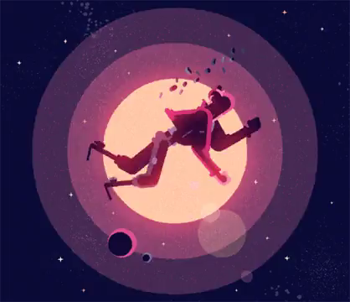
Linear motion and force

Slide 2
Vectors & Uniform Motion

Slide 3
Learning Intentions
• Define the terms vector and scalar.
• Use the terms vector and scalar to categorise physical quantities.
• Calculate resultant vectors through the addition of two vectors.
• Identify the units of distance and time.
• Recall how distance is measured.
• Recall how time is measured.
• Calculate displacements.
• State Pythagoras' Theorem.
• Calculate distances using Pythagoras' Theorem.
• Define speed
• State the formula for calculating speed
• Calculate speed using distance and time.
• Define acceleration.
• State the formula for calculating acceleration.
• Calculate acceleration.
• Explain what a distance-time graph is.
• Use these graphs to calculate speed.
• Recall the kinematic equations.
• Solve problems using the kinematic equations.

Slide 4
Vectors and scalars defined
Scalar is defined as a quantity that has a magnitude but no direction.
Vector is defined as a quantity that has both magnitude and direction.

Slide 5
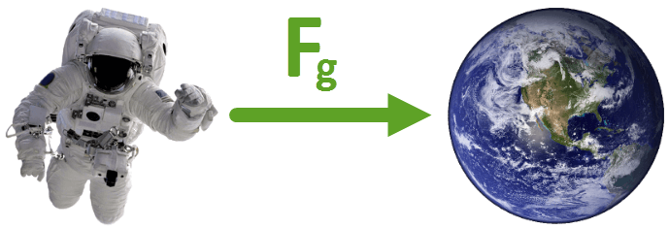
Examples of scalars and vectors
Distance is a scalar, which means it's described by a size only. Other examples of scalars are temperature, speed and mass. None of these quantities have a direction.
Displacement is a vector, which means it's described by a size and direction. Another example of a vector is the acceleration due to the force of gravity, as it has a size (9.8 ms⁻²) and direction (toward the centre of the Earth). Velocity is also a vector quantity.
Both distance and displacement are measured in metres (m).

Slide 6

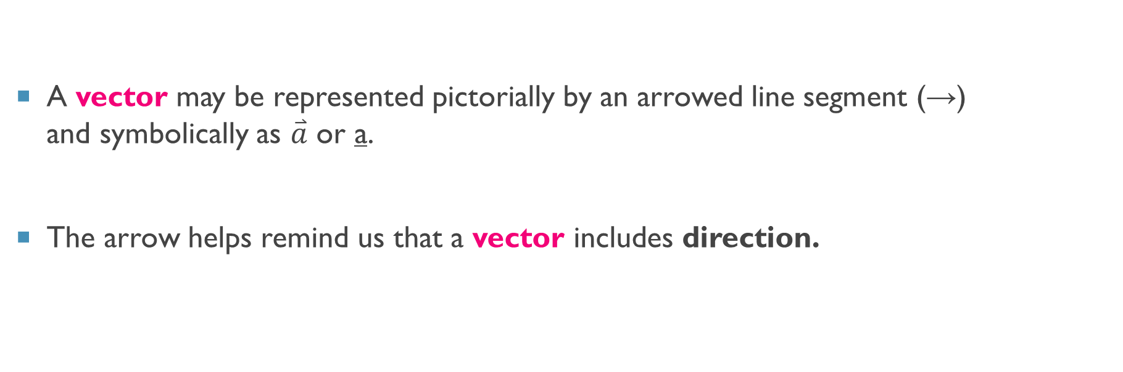
Representing vectors
A vector may be represented pictorially by an arrowed line segment (→) and symbolically as $\overset{⃑}{a}$ or a​.
The arrow helps remind us that a vector includes direction.

Slide 7
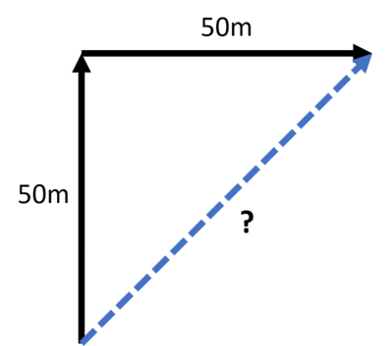
Scalar addition
For example, if I walk 50 m then walk another 50 m, how far have I walked?
In this case, it is simply the sum of the two values.
50+50=100 m
But what if I want to consider direction as well?
If I walk 50 m north, then 50 m east, how far from the starting point am I?

Slide 8
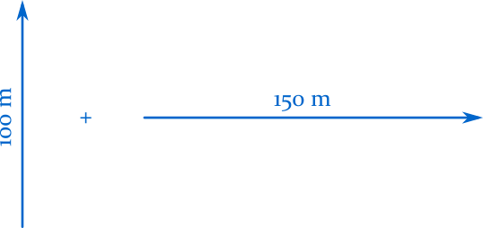
Vector addition
Adding two vectors together yields another vector, with a size and direction of its own.

Slide 9
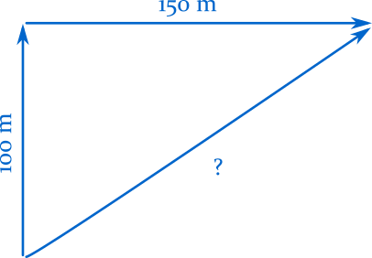
Vectors are added by connecting the arrowhead of one vector to the tail of a second vector.
The sum of the two vectors is the distance and direction from the tail of the first, to the tip of the second:

Slide 10
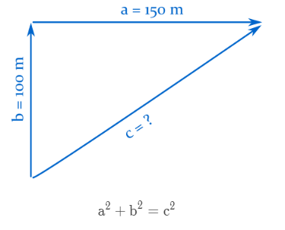
We calculate the size of the new vector with the Pythagorean theorem:

Slide 11
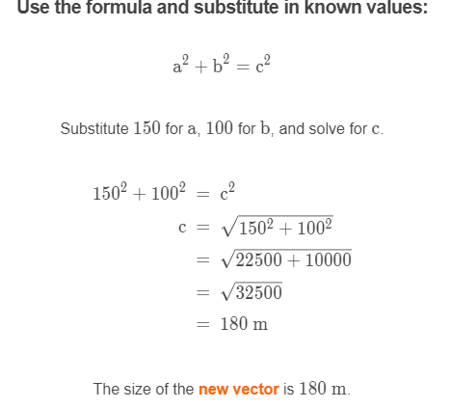
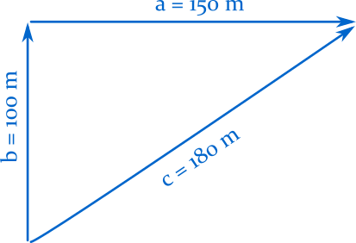

Slide 12
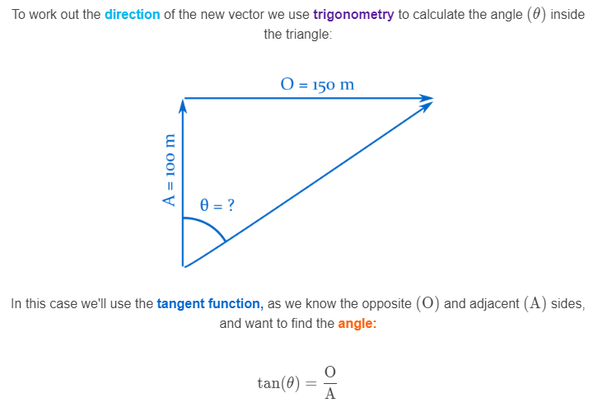
What about the direction?

Slide 13
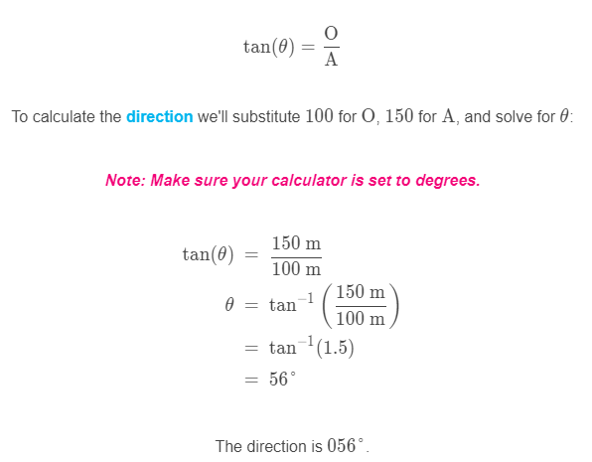
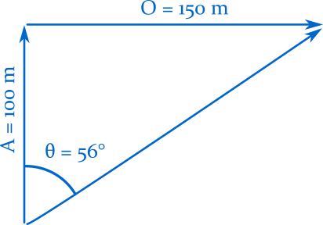

Slide 14
Distance
The distance an object travels is the amount of ground it covers.

Slide 15
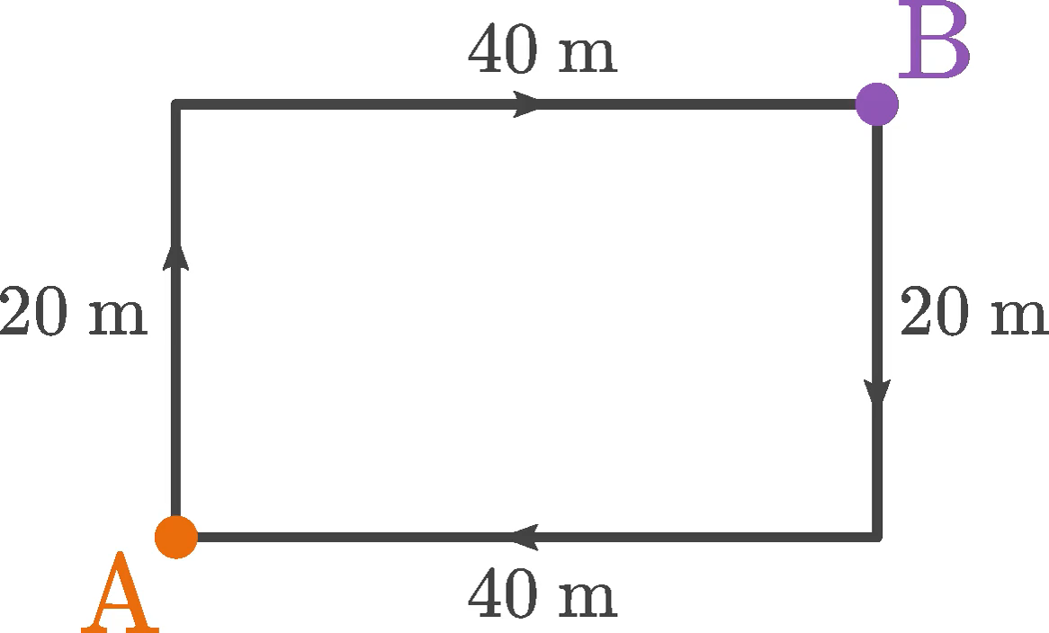
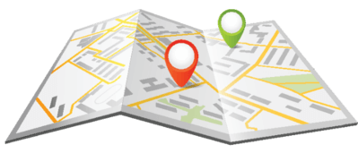
Calculating Total Distance
To find the distance between A and B, you need to add 20 m to 40 m. This means you covered a total distance of 60 m.
20 m+40 m=60 m

Slide 16
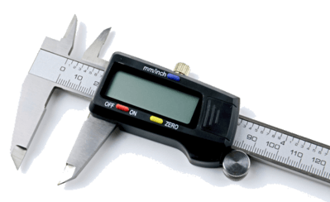
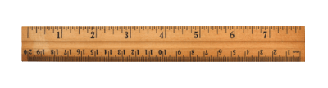
Units of distance
Distance is measured in the unit of metres (m). You can measure distances with a ruler, a measuring tape or if you need high precision, a digital caliper.
Distance is a scalar quantity. This means that the distance you walk has a size or magnitude, but the direction you walk in doesn't matter.

Slide 17

Displacement
Displacement is a similar measure to distance, but it also tells you the direction in which an object has moved.
We use the symbol "s" to denote displacement, and its unit is metres (m).
For example, an object may have moved a distance of 2 m but have a displacement of 2 m to the left.

Slide 18
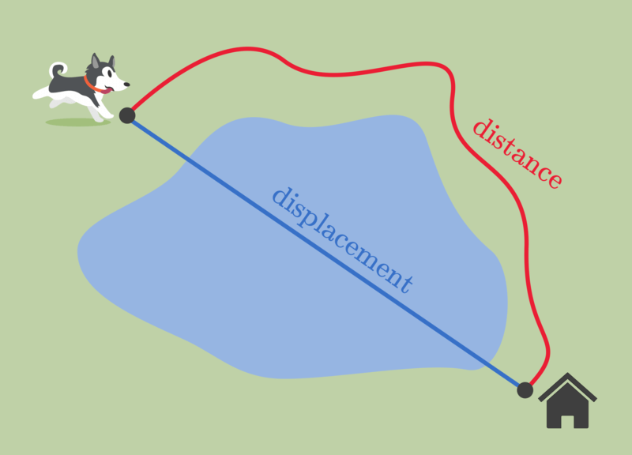
Displacement defined
The displacement of an object is the shortest distance between the object's starting position and its final position.
Harold the husky has to run around a pond in order to get home.
The length of the red path that he travels is the distance he runs.
However, his displacement is the direct distance between where he started and home.

Slide 19
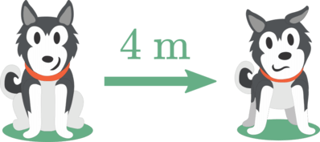
Displacement is a vector
This means that it has a magnitude (size) and a direction.
For example, if your displacement is 4 m to the right, the magnitude of the displacement is 4 m and the direction of the displacement is to the right.

Slide 20
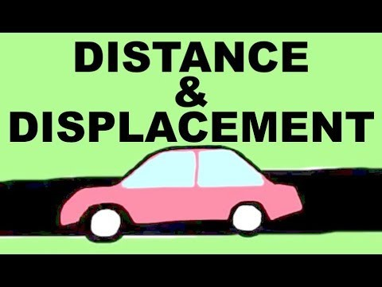

Slide 21
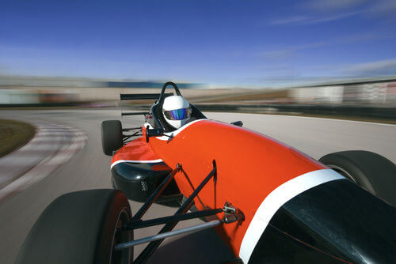
Speed
When objects move, they travel a certain distance in a certain time.
We can use these two quantities to find the speed of the object. Speed tells us how fast something moves!

Slide 22
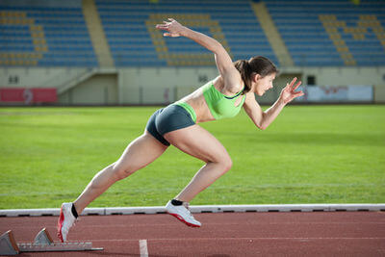
Speed defined
Speed describes how fast something is moving.
It is defined as the change in distance over change in time.
We measure speed in metres per second (m/s), which can also be written as ms⁻¹.

Slide 23
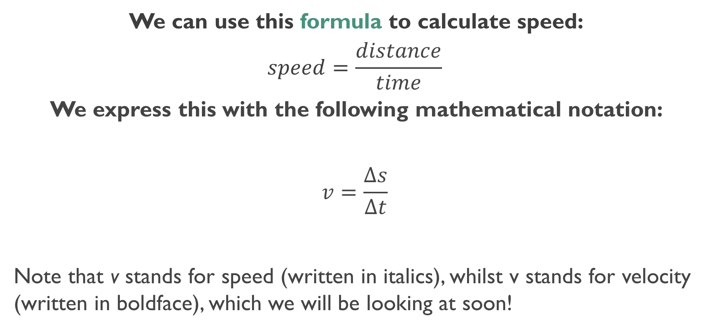
Speed formula
We can use this formula to calculate speed:
$$speed=\frac{distance}{time}​$$ We express this with the following mathematical notation:
$$v=\frac{Δs}{Δt}​$$
Note that v stands for speed (written in italics), whilst v stands for velocity (written in boldface), which we will be looking at soon!

Slide 24
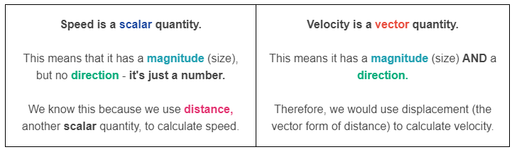
Speed vs velocity
The terms speed and velocity of are often used interchangeably. However, there is a subtle but very important difference!

Slide 25
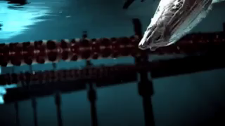
Acceleration is a change in an object's velocity over time.
Remember, velocity is very similar to speed, but it acts in a certain direction.
This means that an object accelerates when it speeds up, slows down or changes direction.

Slide 26

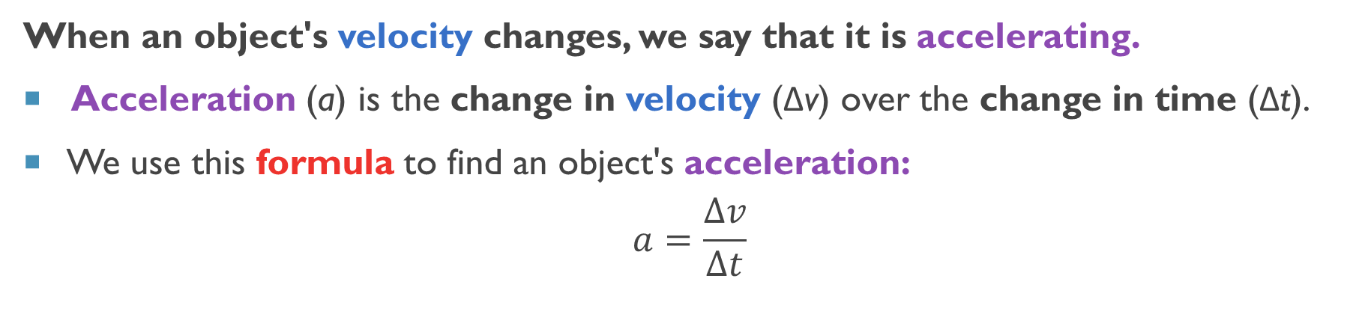
Acceleration equations
When an object's velocity changes, we say that it is accelerating.
Acceleration (a) is the change in velocity (Δv) over the change in time (Δt).
We use this formula to find an object's acceleration:
$$a=\frac{∆v}{∆t}$$

Slide 27
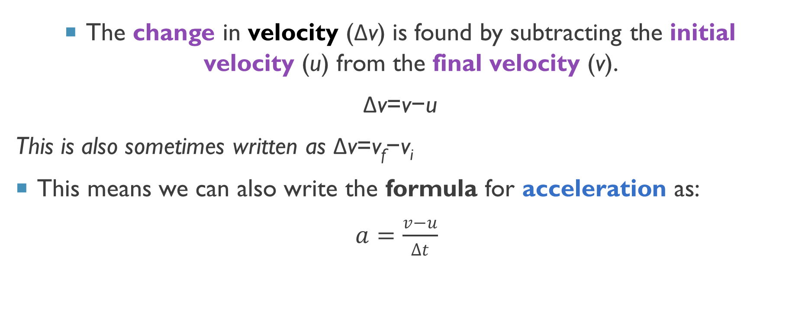
The change in velocity (Δv) is found by subtracting the initial velocity (u) from the final velocity (v).
Δv=v−u
This is also sometimes written as Δv=v_{f}​−v_{i​}
This means we can also write the formula for acceleration as:
$a=\frac{v−u}{∆t}$

Slide 28
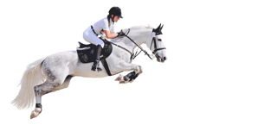
Acceleration
If an object is speeding up in a positive direction, it has a positive acceleration.
This is because the final velocity is greater than the initial velocity, so there is a positive change in velocity.

Slide 29
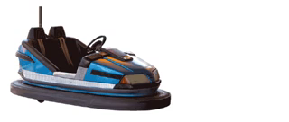
Negative Acceleration
If an object is slowing down in a positive direction, it has a negative acceleration.
Acceleration is acting in the opposite direction to velocity.
This is because the final velocity is less than the initial velocity, so there is a negative change in velocity.

Slide 30

Units of acceleration
Acceleration has the unit metres per second squared.
This is written as m/s² or ms⁻².

Slide 31
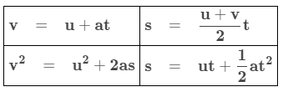
Kinematic equations
In the above equations, "s" can also be written as "d" (displacement). Also "v" may be written "v_{f}​" (final velocity) and "u" may be written "v_{i}​" (initial velocity).
These equations can only be used when the object you're looking at has a constant acceleration. You will be given enough data to use at least one equation; if you have a choice, use the one that requires the least algebra to solve.

Slide 32
When we record the motion of an object, we are usually interested in these five quantities of motion:
Initial speed (u or v_{i​})
Displacement (s or d)
Acceleration (a)
Final speed (v or v_{f​})
Time (t)

Slide 33
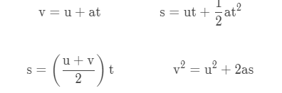
Using Kinematic equations
To work out unknown values we use equations called the kinematic equations.
For any given problem you will need to:
List known values from v, u, a, s, and t.
Identify the unknown value.
Select an appropriate kinematic equation.
Solve the problem and answer the question.

Slide 34
Newton’s Laws

Slide 35
Learning Intentions
Explain the differences between contact and non-contact forces.
Understand how to draw forces on an object.
Recall what gravity is.
Explain how gravity acts on objects in different situations.
Explain the relationship between gravity, weight and mass.
Calculate weights on different planets.
Recall Newton's First Law.
Determine if an unbalanced force has been applied to an object.
Explain the concept of inertia.
Explain Newton's Second Law.
Recall the formula for Newton's Second Law.
Use Newton's Second Law to calculate mass and acceleration.
Recall Newton's Third Law.
Explain the consequences of Newton's Third Law.
Explain how seat belts use action-reaction pairs to keep passengers safe.

Slide 36
Types of forces
F_{g​} is the force of gravity, or the weight of an object.
F_{N}​ is the normal, which is a contact force between an object and a surface.
F_{A}​ is an applied force, such as a push or pull on the object.
F_{f}​ is the frictional force, which acts in the opposite direction to motion.
F_{L}​ represents lift, for example the lift on the wings of a plane due to the Bernoulli effect.
F_{B}​ represents buoyancy, which supports objects in a fluid.
F_{T}​ is the tension force, such as in a string or wire.

Slide 37
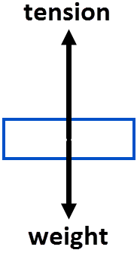
Free Body Diagrams
Free-body diagrams are a simple way to represent the forces on an object.
The object is drawn as a simple shape, such as a circle or rectangle.
The forces acting on the object are drawn as vector arrows.
The length of the arrows represents the magnitude of the force, whilst the direction of the arrow shows the direction the force acts.

Slide 38
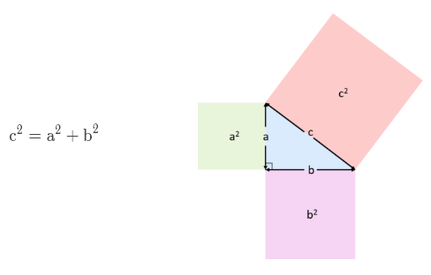
Forces in multiple dimensions
When forces are in one dimension they can be added if they are in the same direction, or subtracted if they are in opposite directions.
When forces are in two dimensions, Pythagoras' theorem must be used to calculate the net force.

Slide 39
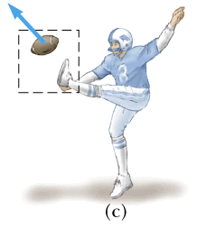
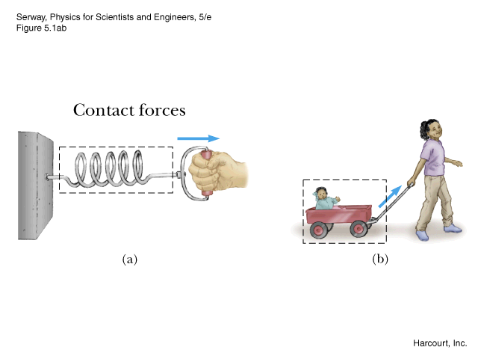
Contact forces
Involves physical contact between objects.

Slide 40
Examples of contact forces
Pushing, pulling or twisting are the most common.
Adhesion – a force of attraction between different materials (e.g. Sellotape and paper, or the attraction between water and glass tubing - meniscus).
Cohesion – a force of attraction between particles of the same material (e.g. the attraction between water molecules that become rain droplets).
Surface Tension – a force of attraction between molecules across the surface of a liquid, which can be strong enough in water to support the weight of some insects.

Slide 41
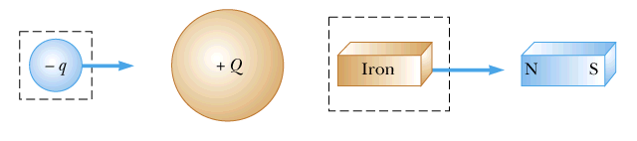
Non-contact forces
No physical contact between objects.
Forces act through empty space.

Slide 42
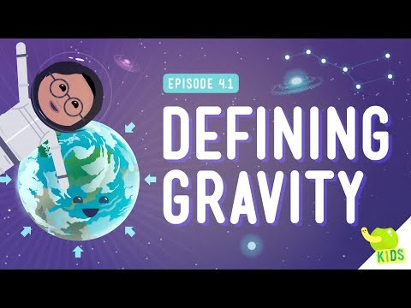

Slide 43
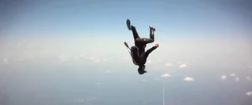
Gravity
Gravity is the attraction between two masses.
However, we only notice gravity for extremely large masses because it is so weak.
This is why you feel pulled towards the Earth but not towards your pet cat or anything else in the room.

Slide 44
Big Masses and gravity
Gravity is only noticeable for really big masses, such as the Earth.
The Earth's gravity holds everything down to Earth, like building, trees and people.
Gravity pulls things toward the centre of the Earth. This is why you can be anywhere along the surface of the Earth and not fall off.

Slide 45
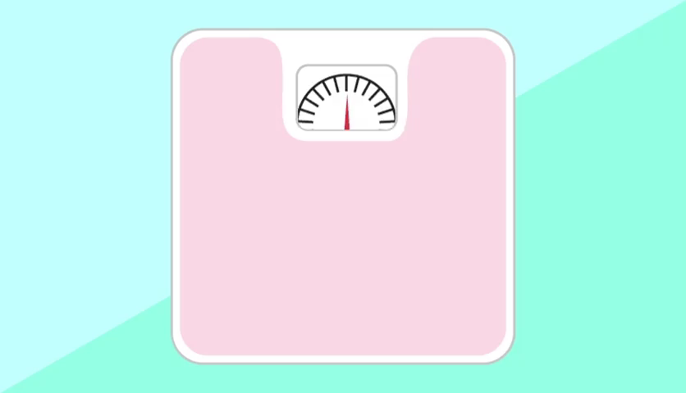
Mass and Weight
In everyday life, the terms mass and weight are interchangeable. However, in physics they have special meanings.
Mass is the amount of matter in an object, measured in kilograms (kg). Your mass is the same (constant) wherever you are, even if you go to a different planet!

Slide 46
Weight is the force acting on an object due to gravity.
It is the gravitational force between an object and the planet it is sitting on.
It is a way of measuring the effect of gravity on objects on the surface of a planet.
Weight is measured in newtons, just like every other force.

Slide 47
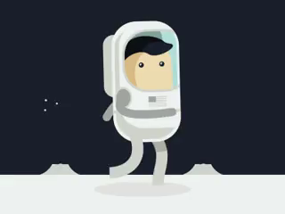
How does mass affect weight?
Your weight changes on planets with different gravity to Earth, however your mass is always the same, no matter where you are!
Two objects with different masses will have a different weight force on Earth.
An object with a greater mass will have a stronger weight force than an object with a smaller mass.

Slide 48
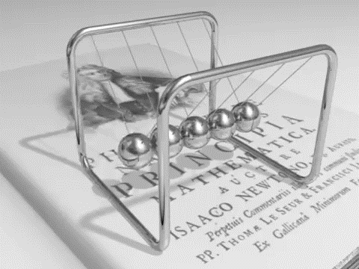
Newton’s first law
An object will remain in a state of constant motion unless an unbalanced force acts on it.

Slide 49

In other words, the first law states that an object will resist change in motion, unless a force is applied to change the motion.
This means that an object travelling at a constant velocity can only change its speed or direction if an unbalanced force acts on it.

Slide 50
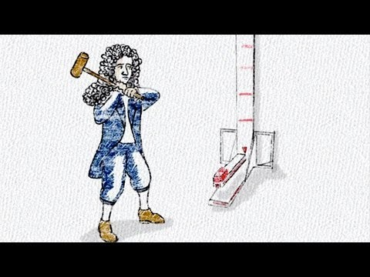

Slide 51
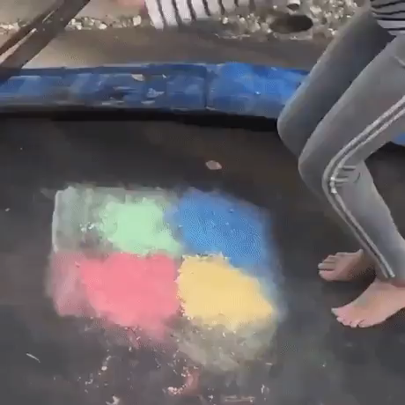
Inertia
Newton's First Law arises due to a property called inertia.
Inertia is the tendency of an object to resist a change in its motion.

Slide 52
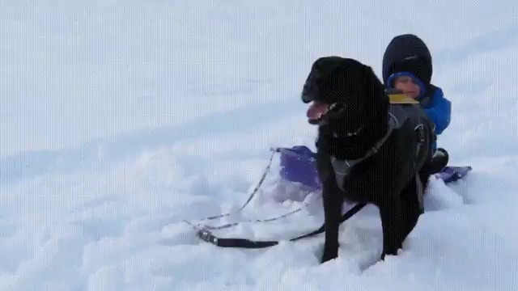
What is inertia?
The inertia of an object means that it either wants to remain stationary or to continue travelling in a straight line at a constant speed.
We need to apply an unbalanced force to the object to overcome its inertia.
For example, in the image below, the dog did not apply an unbalanced force to the baby, so the baby's inertia kept it in the same place.

Slide 53
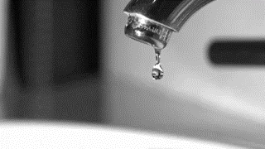
Newton’s Second Law
Newton's Second Law says that an object will accelerate in the direction of an unbalanced force acting on it.
The size of the acceleration depends on the object's mass and the size of the net force acting on it.
For example, gravity applies an unbalanced force to this drop of water, which then accelerates downwards.

Slide 54

Newton’s second law equation
F_{net}​ is the net force acting on the object, measured in newtons (N).
The mass of the object is represented by m and it is measured in kilograms (kg).
Finally, a_{net}​ represents the acceleration of the object, measured in meters per second squared (m/s²).

Slide 55
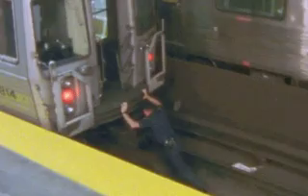
Mass and Newton’s Second Law
According to Newton's Second Law, we need to apply a larger force to accelerate a heavier object.
You probably knew this - you didn't need Newton to tell you that it's harder to push heavy objects than light ones!

Slide 56
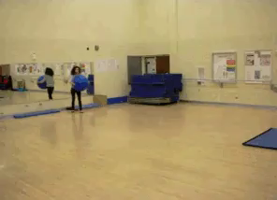
Newton’s third law
For every action force, there is an equal and opposite reaction force.

Slide 57
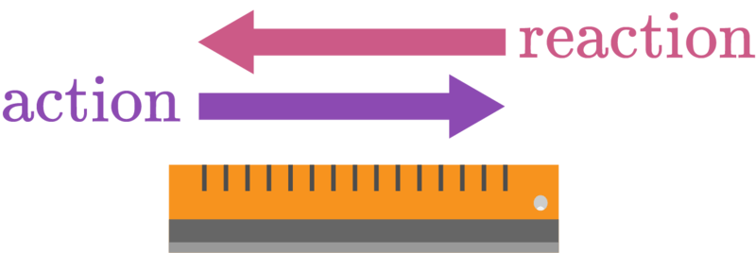
Newton's Third Law means that forces come in pairs.
When one object exerts a force on another object, the second object must exert another force back on the first one.
The force that the first object exerts is the action force. The force that is exerted in response to the action force is the reaction force.

Slide 58

The reaction force is the same size as the action force.
However, the reaction force points in the opposite direction to the action force.

Slide 59
Energy

Slide 60
Learning Intentions
• Define energy.
• Recall the two main types of energy. Define kinetic energy.
• Explain how work and mass influence kinetic energy.
• Identify the different types of kinetic energy.
• Identify and describe the three types of potential energy.
• Distinguish potential energy from kinetic energy.
• Solve problems involving kinetic energy and gravitational potential energy.
• Define the term mechanical work.
• Solve problems involving work done by a force.

Slide 61

What is Energy?
Energy is the ability of an object to do work.
If an object is doing work, it is making something happen. Walking, running, cycling and swimming are all types of work because you use energy to do them.

Slide 62

Energy defined
Energy is defined by what it does.
It has many different forms, all named after what the energy is doing in that form.
Energy is able to transform between these forms, and can be transferred between objects. Work is done when energy is transformed or transferred.

Slide 63
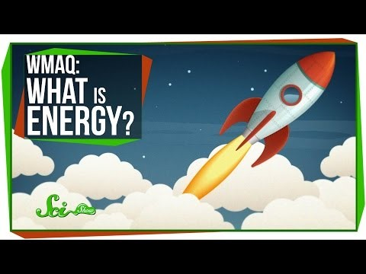

Slide 64
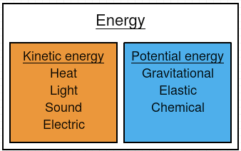
Types of Energy
Energy can be split into two different types: kinetic energy and potential energy.
Kinetic energy is energy associated with movement. Potential energy is energy that is stored in objects.

Slide 65

Kinetic energy
The most familiar type of kinetic energy is the energy used to move things from one point to another.
If you're moving, you are using kinetic energy!

Slide 66
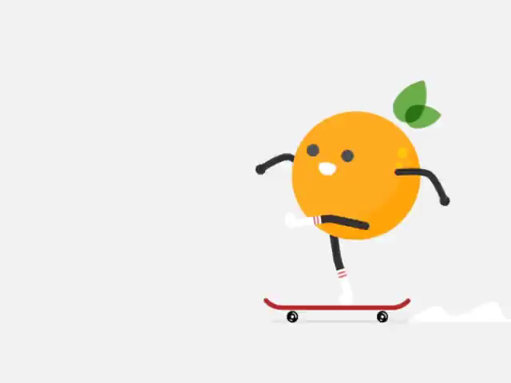
Quick and Slow
If an object is moving quickly, it has a high kinetic energy (KE). If it is moving slowly, it will have very little kinetic energy.
Kinetic energy is also affected by mass. Heavier objects have more kinetic energy than light objects.

Slide 67
Potential energy
Potential energy is also known as stored energy, because it is stored in objects.
Lots of things have potential energy!
For example, your phone and laptop have batteries that store energy for the devices to use. Food has potential energy that we take when we eat it.

Slide 68


Gravitational potential energy
Gravitational potential energy (GPE) is energy stored in an object due to its position (height).
We can calculate gravitational potential energy from the following formula:

Slide 69
There are three factors that the gravitational potential energy depends on. These are:
Mass
Acceleration due to gravity
Height
The unit for mass is the kilogram (kg).
The unit for height is the metre (m).
The unit for energy is the joule (J). Acceleration due to gravity is a constant, so it is always: 9.8Nkg⁻¹

Slide 70


Kinetic energy formula
Kinetic energy is calculated by using this formula: $$E_{k}​=\frac{1}{2}​mv^{2}$$
This can also be written as:
$$E_{k}​=\frac{1}{2}​×m×v^{2}$$
In this formula, E_{k​} represents kinetic energy, m represents mass, and v represents speed.

Slide 71

Units of the kinetic formula
When we use this formula, the mass must be in kilograms (kg) and the speed must be in metres per second (ms⁻¹).
This gives the kinetic energy in joules.

Slide 72

Work
Work is the amount of energy that is transferred to an object when a force causes it to move.
If the object does not move, then no work has been done on it!
Similarly, if there is no force being applied to the object, there is no work being done on it, even if the object continues moving.

Slide 73

Mechanical work
Mechanical work is defined as the transfer of energy to or from an object by the action of a force over a distance.

Slide 74

Units of work
The unit for work is the joule (J).
We use joules as a unit for work because work is the amount of energy that is transferred to an object, and energy is measured in joules.
As work is the product of force and distance, the units are also newton metres (Nm).
1 J=1 Nm

Slide 75
Work equation
Work is done when a force acts over a distance.
This can be used to calculate work, which is the product of force and distance.
W=F×d
Work done = Force × distance

Slide 76

Force on an angle - work
Sometimes forces are applied on an angle. When this occurs we only look at the component of force that is parallel to the direction the object moves in. This means that a force acting perpendicular to the direction of motion does no work on the object.
When a force is applied in the same direction as the motion we use the formula:
W=Fd
When a force is applied on an angle we use the formula:
W=Fdcosθ

Slide 77
Hooke’s Law
Hooke's Law describes the force acting on a spring. This force changes based on displacement from the equilibrium.
Force on a spring is proportional to the extension of the spring (Δx), but it is in the opposite direction to extension. This is represented by the negative sign in the formula.
F=−kΔx
k is the proportionality constant of the spring. It represents how stiff the spring is. It is also called the spring constant.

Slide 78

Power defined
Power is defined as the rate at which work is done or the rate at which energy is transferred or transformed.
Power is calculated using the following equations:
$$P=\frac{ΔW}{Δt}​=\frac{ΔE}{Δt}​$$
Where P is power, W is work, t is time and E is energy. The delta symbol Δ is used to represent a change in a value.

Slide 79

Units of Power
The SI unit for power is W (Watts).
One watt is equal to one Joule per second (Js⁻¹) or one Newton-metre per second (Nms⁻¹).
Our homes use massive amounts of power, so we often use large units to measure these.

Slide 80

The power output of a car's engine is one of the factors which determines the top speed of the car.
In order to keep the car travelling at a constant speed, the engine must convert energy stored in the fuel to other forms of energy.
Air resistance increases as the car goes faster, decreasing the energy of the car as it does work. This means that as the car goes faster, the power needed increases.
P = Fv

Slide 81
Momentum & Conservation of Energy

Slide 82
Learning Intentions
• Define the term impulse.
• Solve problems involving momentum and impulse.
• Determine and interpret the area under a force-time graph.
• Define the term impulse.
• Solve problems involving momentum and impulse.
• Determine and interpret the area under a force-time graph.
Define the terms elastic collision and inelastic collision.
Compare elastic and inelastic collisions.
Solve problems involving elastic collisions and inelastic collisions.
• Explain how the following car safety systems use the laws of physics to protect passengers during car crashes

Slide 83

Impulse
Impulse is defined as the change in momentum of an object.
It equals the product of a force and the time interval over which the force acts. If you graph the force applied over time, the area under the graph is the impulse.

Slide 84

Impulse from graph
For example, calculate the impulse of an object from the following force-time graph.
Remember, the impulse is the area under the graph.

Slide 85

First divide the area under the graph into simple shapes, then work out the area.
Impulse = area under graph
Impulse = 240 + 180
Impulse = 420 Ns

Slide 86

Impulse formula
An impulse is a force applied over time.
It acts in the same direction as the force, so is a vector.
I=F×Δt
The unit of impulse is the newton-second (Ns).

Slide 87

Impulse and Momentum
Impulse acting on a mass is equal to the change in momentum of the mass.
I=Δp
We can double check this idea by looking at the units of impulse and momentum.

Slide 88

Momentum
In physics, momentum refers to a property of moving bodies.
It is the tendency for a moving object to keep moving in the same direction. An object with lots of momentum is hard to stop!
Momentum is a vector quantity.
This means it has direction as well as magnitude.

Slide 89

Momentum formula
Momentum (p) is the mass (m) of an object multiplied by its velocity (v), as shown by the formula:
p = mv.
Objects that are very massive or moving very fast have a large momentum.

Slide 90

Conservation of momentum
But when we consider multiple objects, with only internal forces between them, we find something interesting. The total momentum of those objects stays the same no matter what they do to each other. This is the idea of conservation.
Conservation of momentum tells us that the total momentum of a system, which could contain an infinite number of objects, is always the same, so long as there is no external force acting.

Slide 91

Collision calculations
When two objects collide, the total momentum is conserved.
Total momentum before = total momentum after
Σpi​=Σpf​
Momentum is calculated as the product of mass × velocity.

Slide 92
If momentum is conserved when two objects collide, it can be used to calculate the final velocity after a collision.

Slide 93

Elastic collision
An elastic collision is defined as a collision in which both momentum and kinetic energy are conserved.
For example, collisions in ideal gases approach perfect elastic collisions. Also, some large-scale interactions such as the slingshot gravitational interactions between satellites and planets are elastic.

Slide 94
Inelastic collision
An inelastic collision is defined as a collision in which kinetic energy is not conserved.
In a perfect inelastic collision, the two bodies join together to form a single body after the collision. Whilst momentum is conserved, the kinetic energy is not, as some is lost to other forms of energy such as heat and sound.

Slide 95

Inelastic collision
An inelastic collision is defined as a collision in which kinetic energy is not conserved.
In a perfect inelastic collision, the two bodies join together to form a single body after the collision. Whilst momentum is conserved, the kinetic energy is not, as some is lost to other forms of energy such as heat and sound.

Slide 96


Slide 97

seatbelts
Seatbelts control distribution of force in a collision. Wearing a seatbelt means that force from the collision is applied to the chest and hips of the passenger, which are much stronger than the abdomen and other body parts. This reduces the injury that people experience from car crashes.
Seatbelts have another benefit. They essentially bind the passenger and car together, ensuring that the passenger moves with the car. This means that the passenger will not fly through the windscreen, or strike the dashboard. This dramatically increases the chances of surviving a crash.

Slide 98

Airbags and Crumple zones
A crumple zone is an area around the passenger which is designed the crumple in a collision. This increases the time interval which the change in momentum lasts for, resulting in less force acting on the passengers.
Airbags increase the time which the force acts on the passenger for. This also results in less force being applied to the passenger. They also spread out the force, so that it is not concentrated on a small area.

